Slide 1
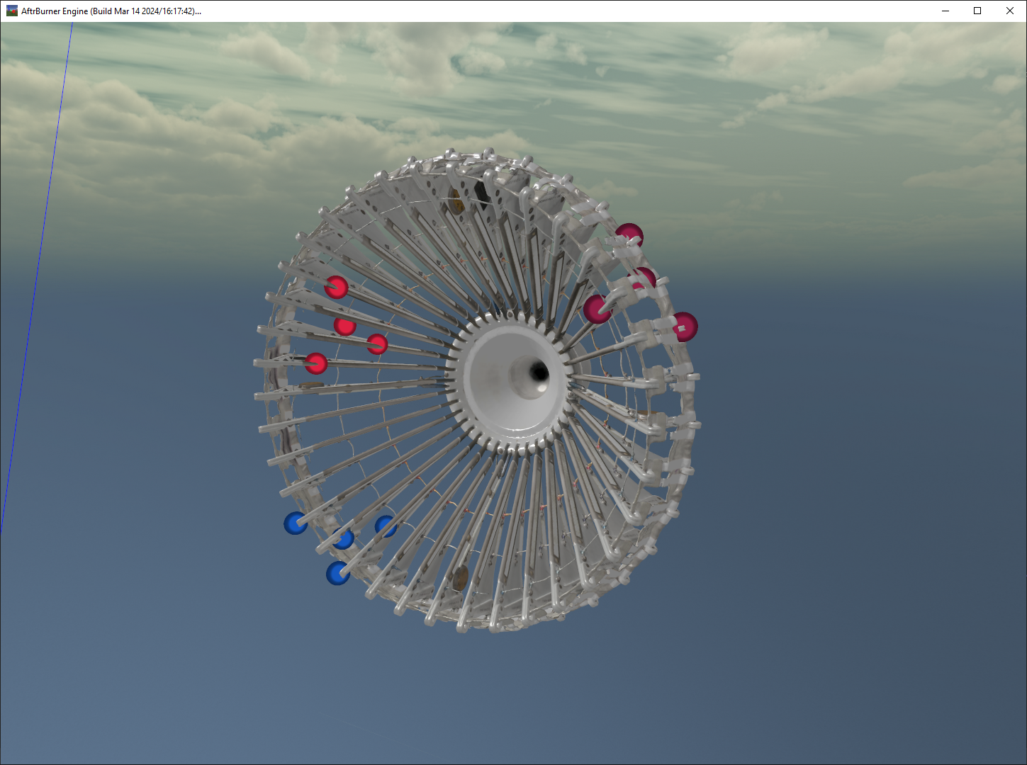
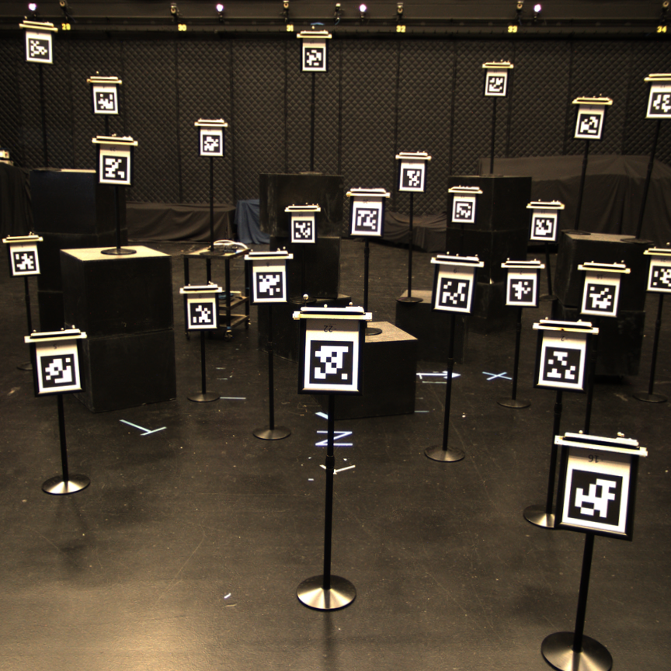
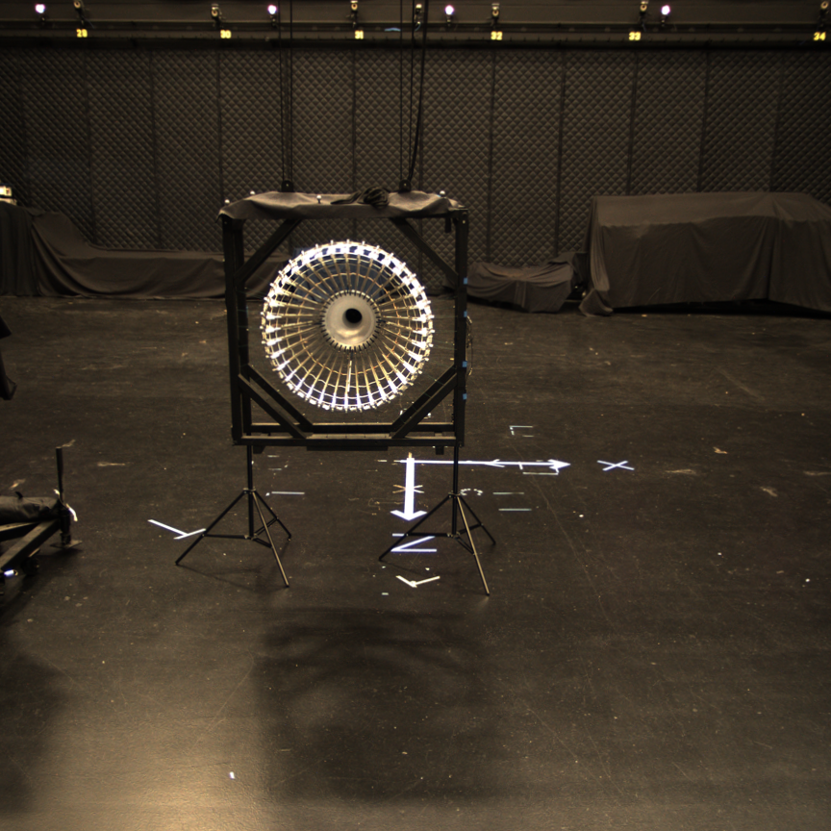
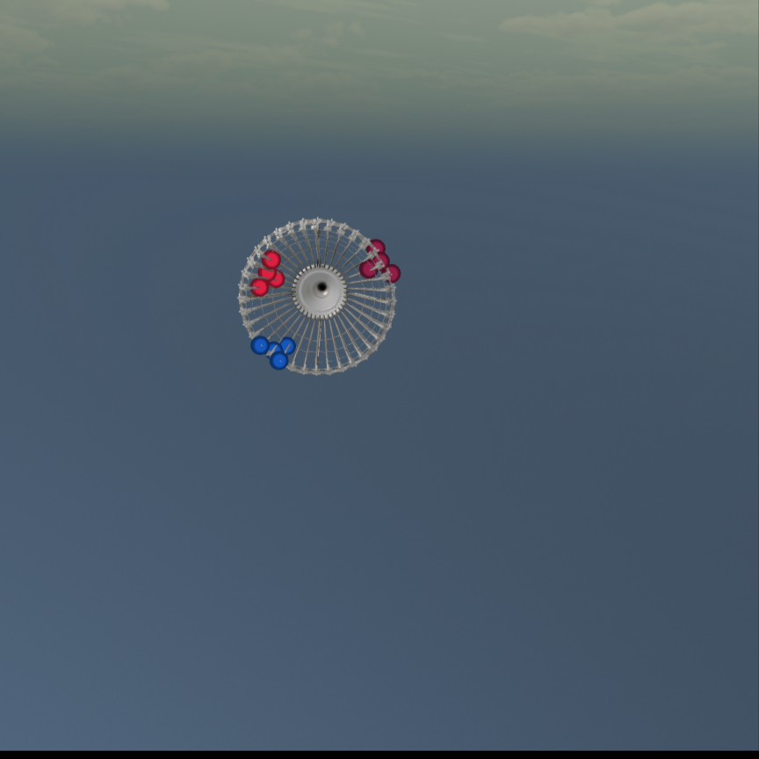

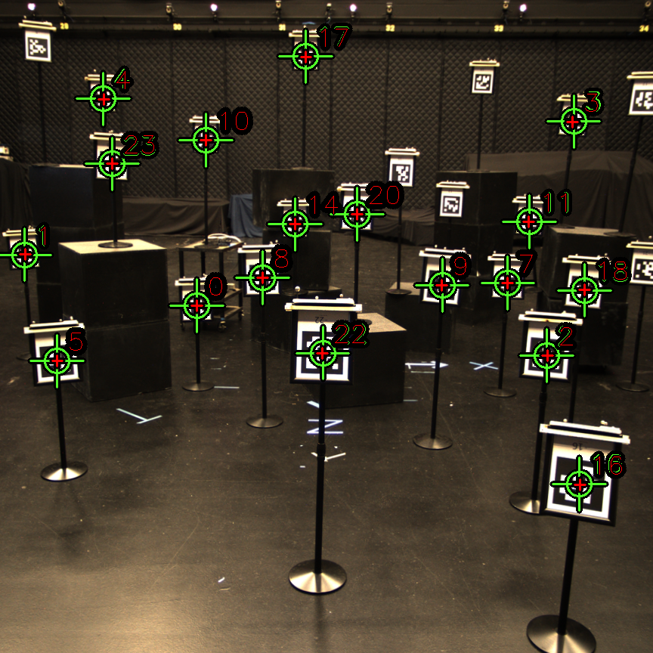
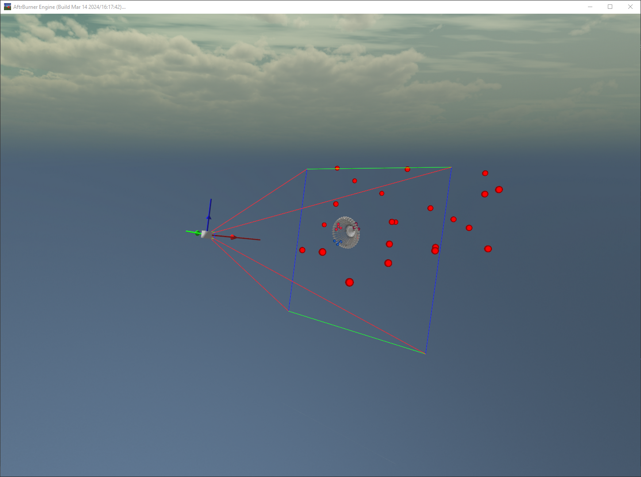
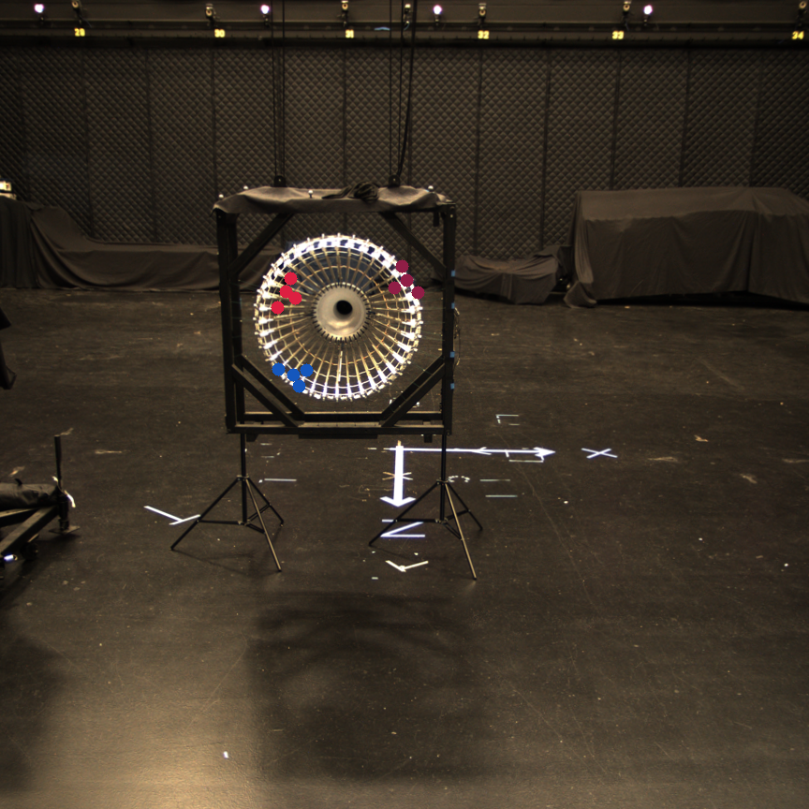
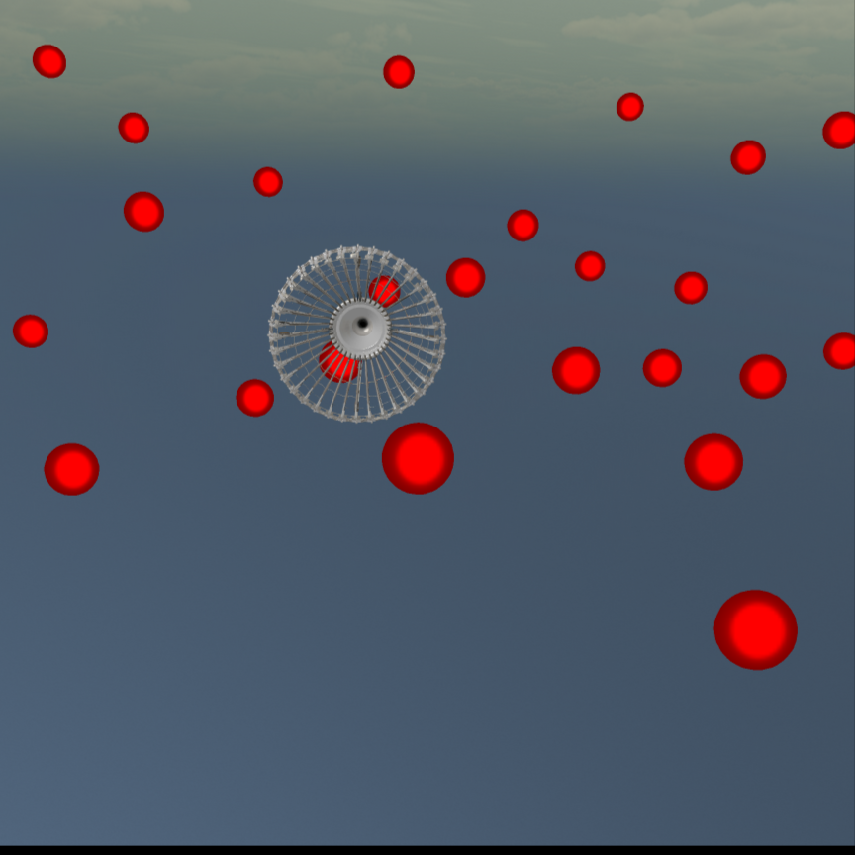
Fix camera to stationary position
Capture image of AprilTags in mocap space
Collect 2D positions of tags in image (AprilTag software)
Collect 3D positions of tags in mocap space (OptiTrack)
Localize camera with 2D/3D positions (PnP)
Capture image of drogue
Collect 6DoF pose of drogue (OptiTrack)
Project drogue feature point clouds into image
Form labels around from projections
Save real image with labels to file
Change the scene
Repeat 4-7
Notes:
Capture 058, img 72 (73.png)

